Slide 1
Ivy Fever: Value(s), Education, and China’s Middle Classes
Britta Ingebretson
March 10, 2012

Slide 2
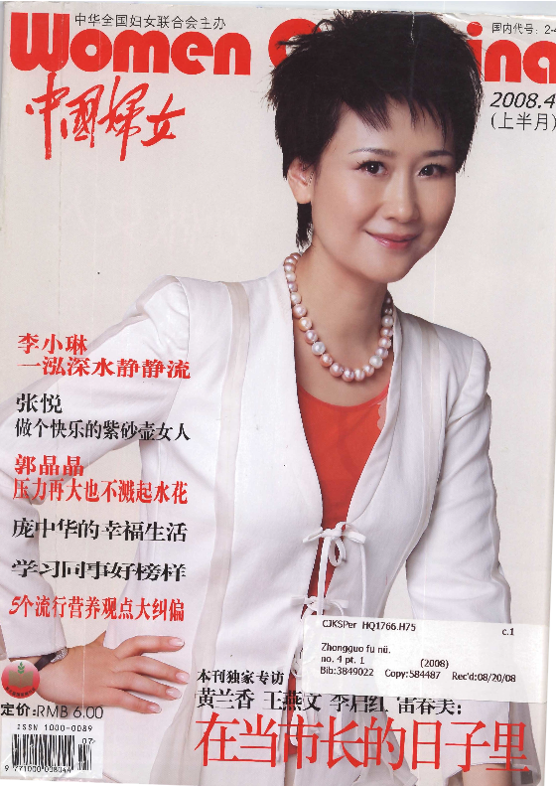
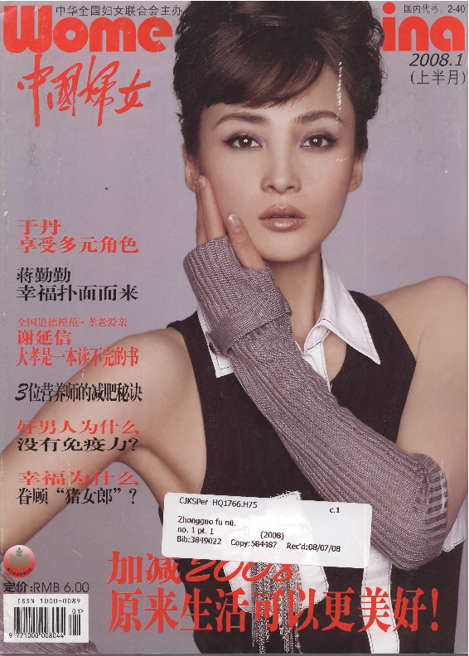
Women of China 2008

Slide 3
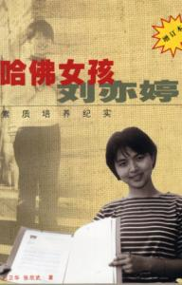
“Harvard Girl Liu Yi Ting”
2000

Slide 4
“women hold up half the sky” Cultural Revolution poster (1966-1976)
Women of China
May, 1979

